Slide 1

School of Computer Science and Engineering (CAT-3, Sem IV)
Course Code:- BSCS2470 Course Name:-Cryptography and network security
GROUP MEMBERS:-
LUBHANSHI
JATIN DAGAR
DIYA NEGI

Slide 2
Branch Coverage is a white box testing method in which every outcome from a code module(statement or loop) is tested. The purpose of branch coverage is to ensure that each decision condition from every branch is executed at least once. It helps to measure fractions of independent code segments and to find out sections having no branches.
For example, if the outcomes are binary, you need to test both True and False outcomes.
The formula to calculate Branch Coverage:

Slide 3
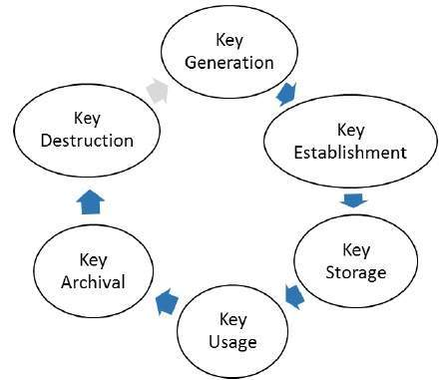
Aspects of Key management
Key management deals with entire key lifecycle as depicted in the following illustration −
Program Name : BSC

Slide 4
Requirements of Key management
There are two specific requirements of key management for public key cryptography.
  Secrecy of private keys. Throughout the key lifecycle, secret keys must remain secret from all parties except those who are owner and are authorized to use them.
  Assurance of public keys. In public key cryptography, the public keys are in open domain and seen as public pieces of data. By default there are no assurances of whether a public key is correct, with whom it can be associated, or what it can be used for. Thus key management of public keys needs to focus much more explicitly on assurance of purpose of public keys.

Slide 5
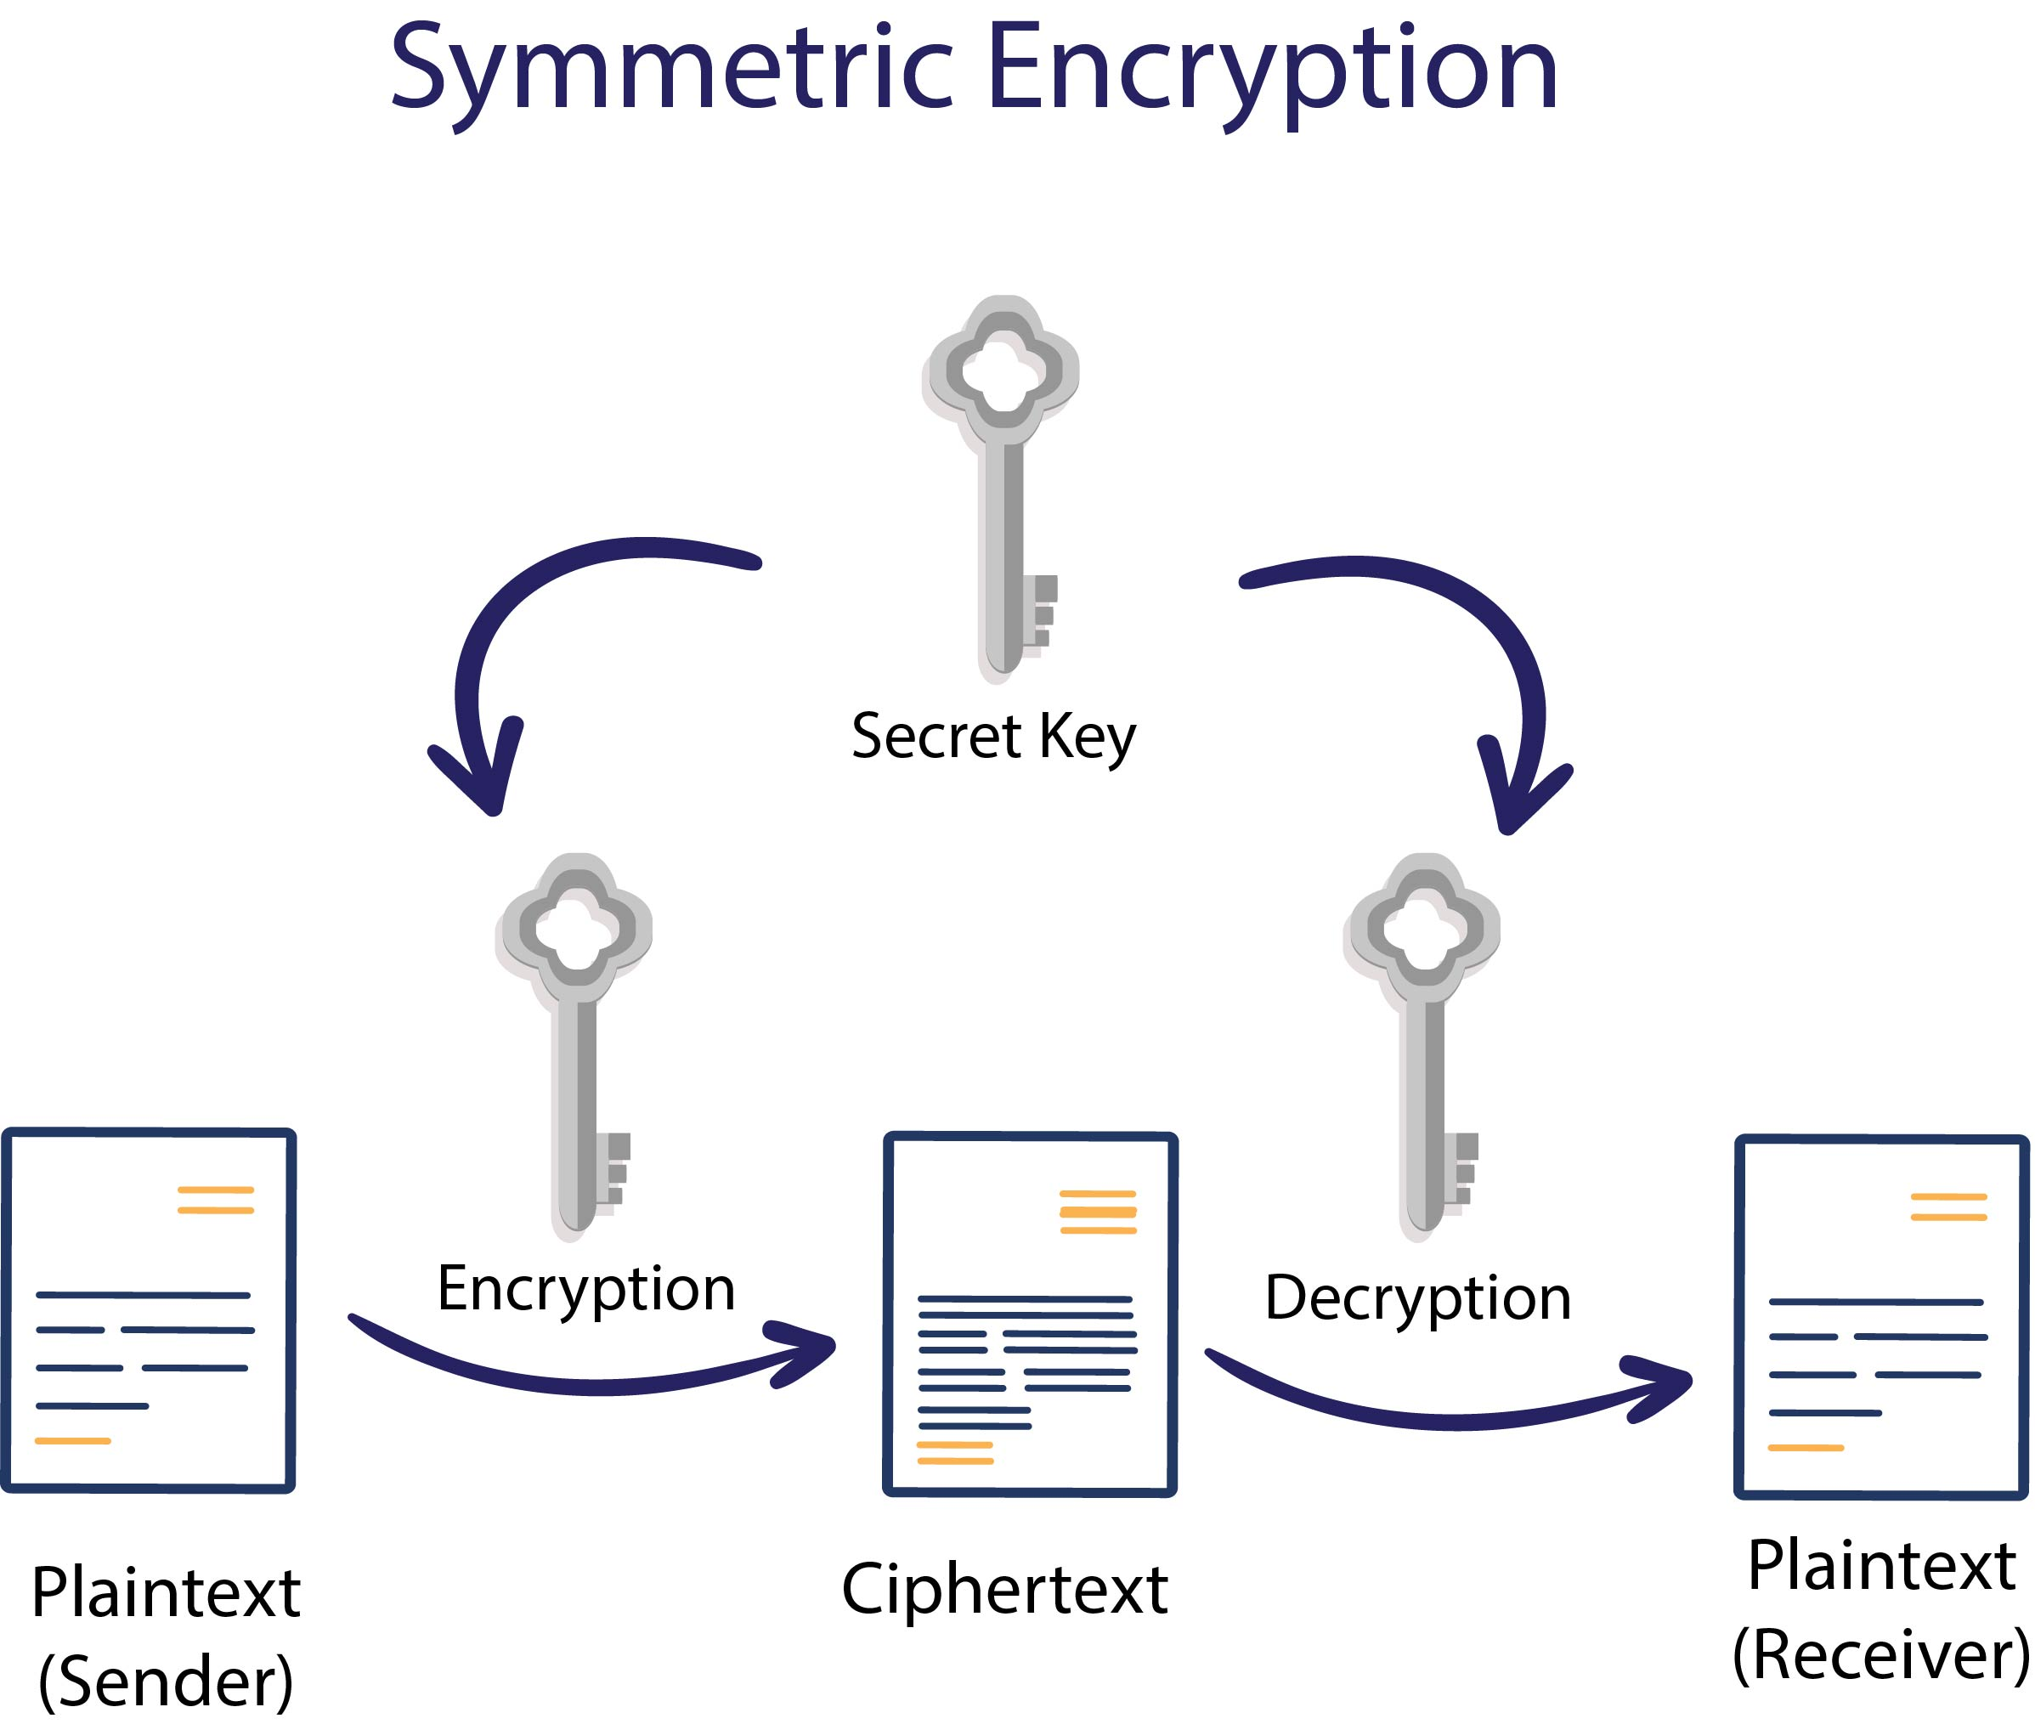
Types of keys
There are two types of cryptographic keys, symmetric and asymmetric keys. Symmetric keys deal with data-at-rest, which is data stored in a static location, such as a database. Symmetric key encryption uses the same key for both encryption and decryption. Asymmetric keys focus on encrypting data-in-motion. Data-in-motion is data sent across a network connection, whether it be a public or private connection. When transporting sensitive data, most encryption processes use both symmetric and asymmetric keys to encrypt data.Aspects of Key management
pectsof Key management

Slide 6
How Key Management Works
Key management follows a lifecycle of operations which are needed to ensure the key is created, stored, used, and rotated securely. Most cryptographic keys follow a lifecycle which involves key
Generation
Distribution
Use
Storage
Rotation
Backup/Recovery
Revocation
Destruction

Slide 7
How Key Management Works
The generation of a key is the first step in ensuring that key is secure. If the key in question is generated with a weak encryption algorithm, then any attacker could easily discover the value of the encryption key. Also, if the key is generated in an insecure location, the key could be compromised as soon as it is created, resulting in a key that cannot be safely used for encryption. Key generators, AES encryption algorithms, or random number generators tend to be used for secure key generation.
The next step of the key lifecycle is ensuring the safe distribution of the keys. Keys should be distributed to the required user via a secure TLS or SSL connection, to maintain the security of the keys being distributed. If an insecure connection is used to distribute the cryptographic keys, then the security of any data encrypted by these keys is in question, as an attacker could execute a man-in-the-middle attack and steal the keys.

Slide 8
How Key Management Works
After distribution of the key, it is used for cryptographic operations. As previously noted, the key should only be used by authorized users, to make certain the key is not misused, copied, etc. When the key is used to encrypt data, it must then be stored for later decryption. The most secure method is via a Hardware Security Module (HSM) or CloudHSM. If an HSM is not used, then the keys can either be securely stored on the client’s side, or, if the keys are used on the Cloud, then the Cloud Service Provider’s Key Management Service can be used.
Once a key’s cryptoperiod, or time period the key is usable, passes, the key must be rotated. When the key of an encrypted set of data expires, the key is retired and replaced with a new key. First the data is decrypted by the old key or key pair and then encrypted by the new key or key pair. Rotation is necessary because the longer a key is in rotation, the more chance there is for someone to steal or find out the key. Rotation of keys can happen before the cryptoperiod expires in cases where the key is suspected to be compromised.

Slide 9
How Key Management Works
Two other ways of dealing with a compromised key are revoking or destroying the key in question. Revoking a key means the key can no longer be used to encrypt or decrypt data, even if its cryptoperiod is still valid. Destroying a key, whether that is due to compromise or due to it no longer being used, deletes the key permanently from any key manager database or other storage method. This makes it impossible to recreate the key, unless a backup image is used. NIST standards require that deactivated keys be kept in an archive, to allow for reconstruction of the keys if data encrypted in the past must now be decrypted by that key or key pair.

Slide 10


